Slide 1
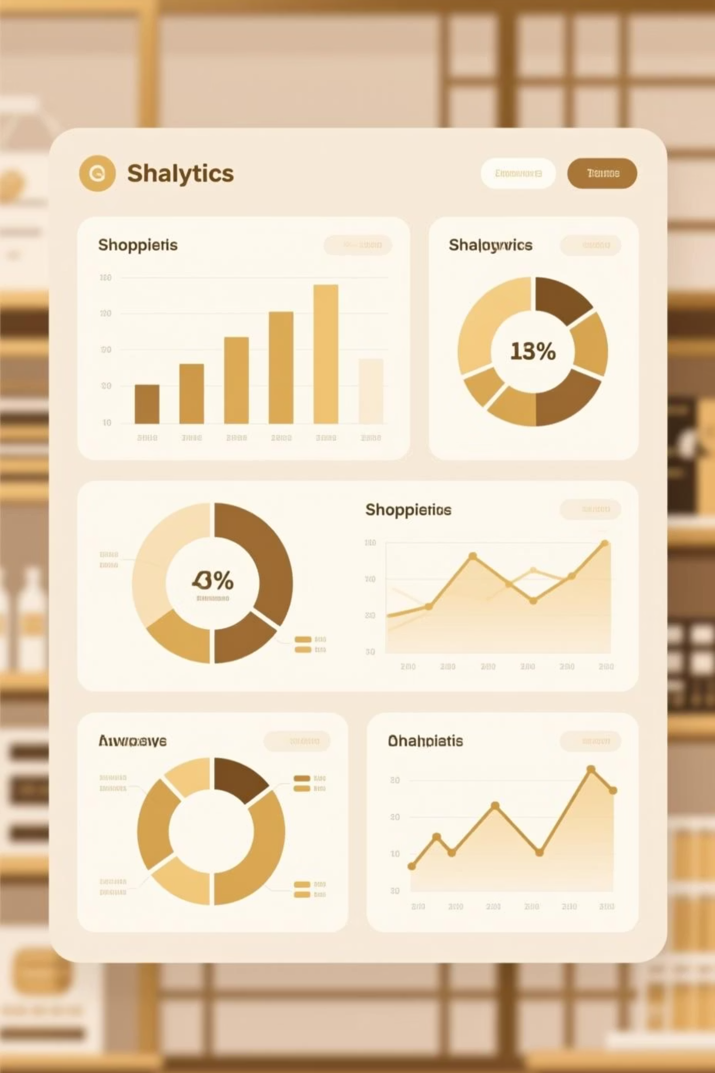
Customer Shopping Behavior Analysis
Uncovering insights from 3,900 purchases to drive strategic business decisions

Slide 2

Dataset Overview
3,900
18
50
Total Purchases
Data Points
Locations
Transactions analyzed
Features per transaction
Geographic coverage
25
Products
Items tracked

Slide 3

Data Preparation Journey
01
Data Loading & Exploration
Imported dataset using pandas, analyzed structure with df.info() and summary statistics
02
Missing Data Handling
Imputed Review Rating nulls using median rating per product category
03
Feature Engineering
Created age_group bins and purchase_frequency_days columns
04
Database Integration
Connected to PostgreSQL for advanced SQL analysis

Slide 4
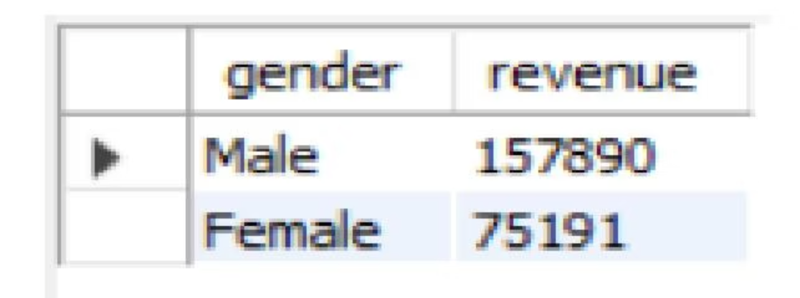
Revenue by Gender
Key Finding
Male customers generate significantly higher total revenue compared to female customers
Strategic Implication: Opportunity to boost female customer engagement

Slide 5

High-Value Discount Users
839 Customers
Smart Shoppers
Revenue Opportunity
Used discounts but spent above average
Seek value without compromising quality
Balance promotions with margin control
These customers demonstrate that discounts can drive premium purchases when strategically applied

Slide 6
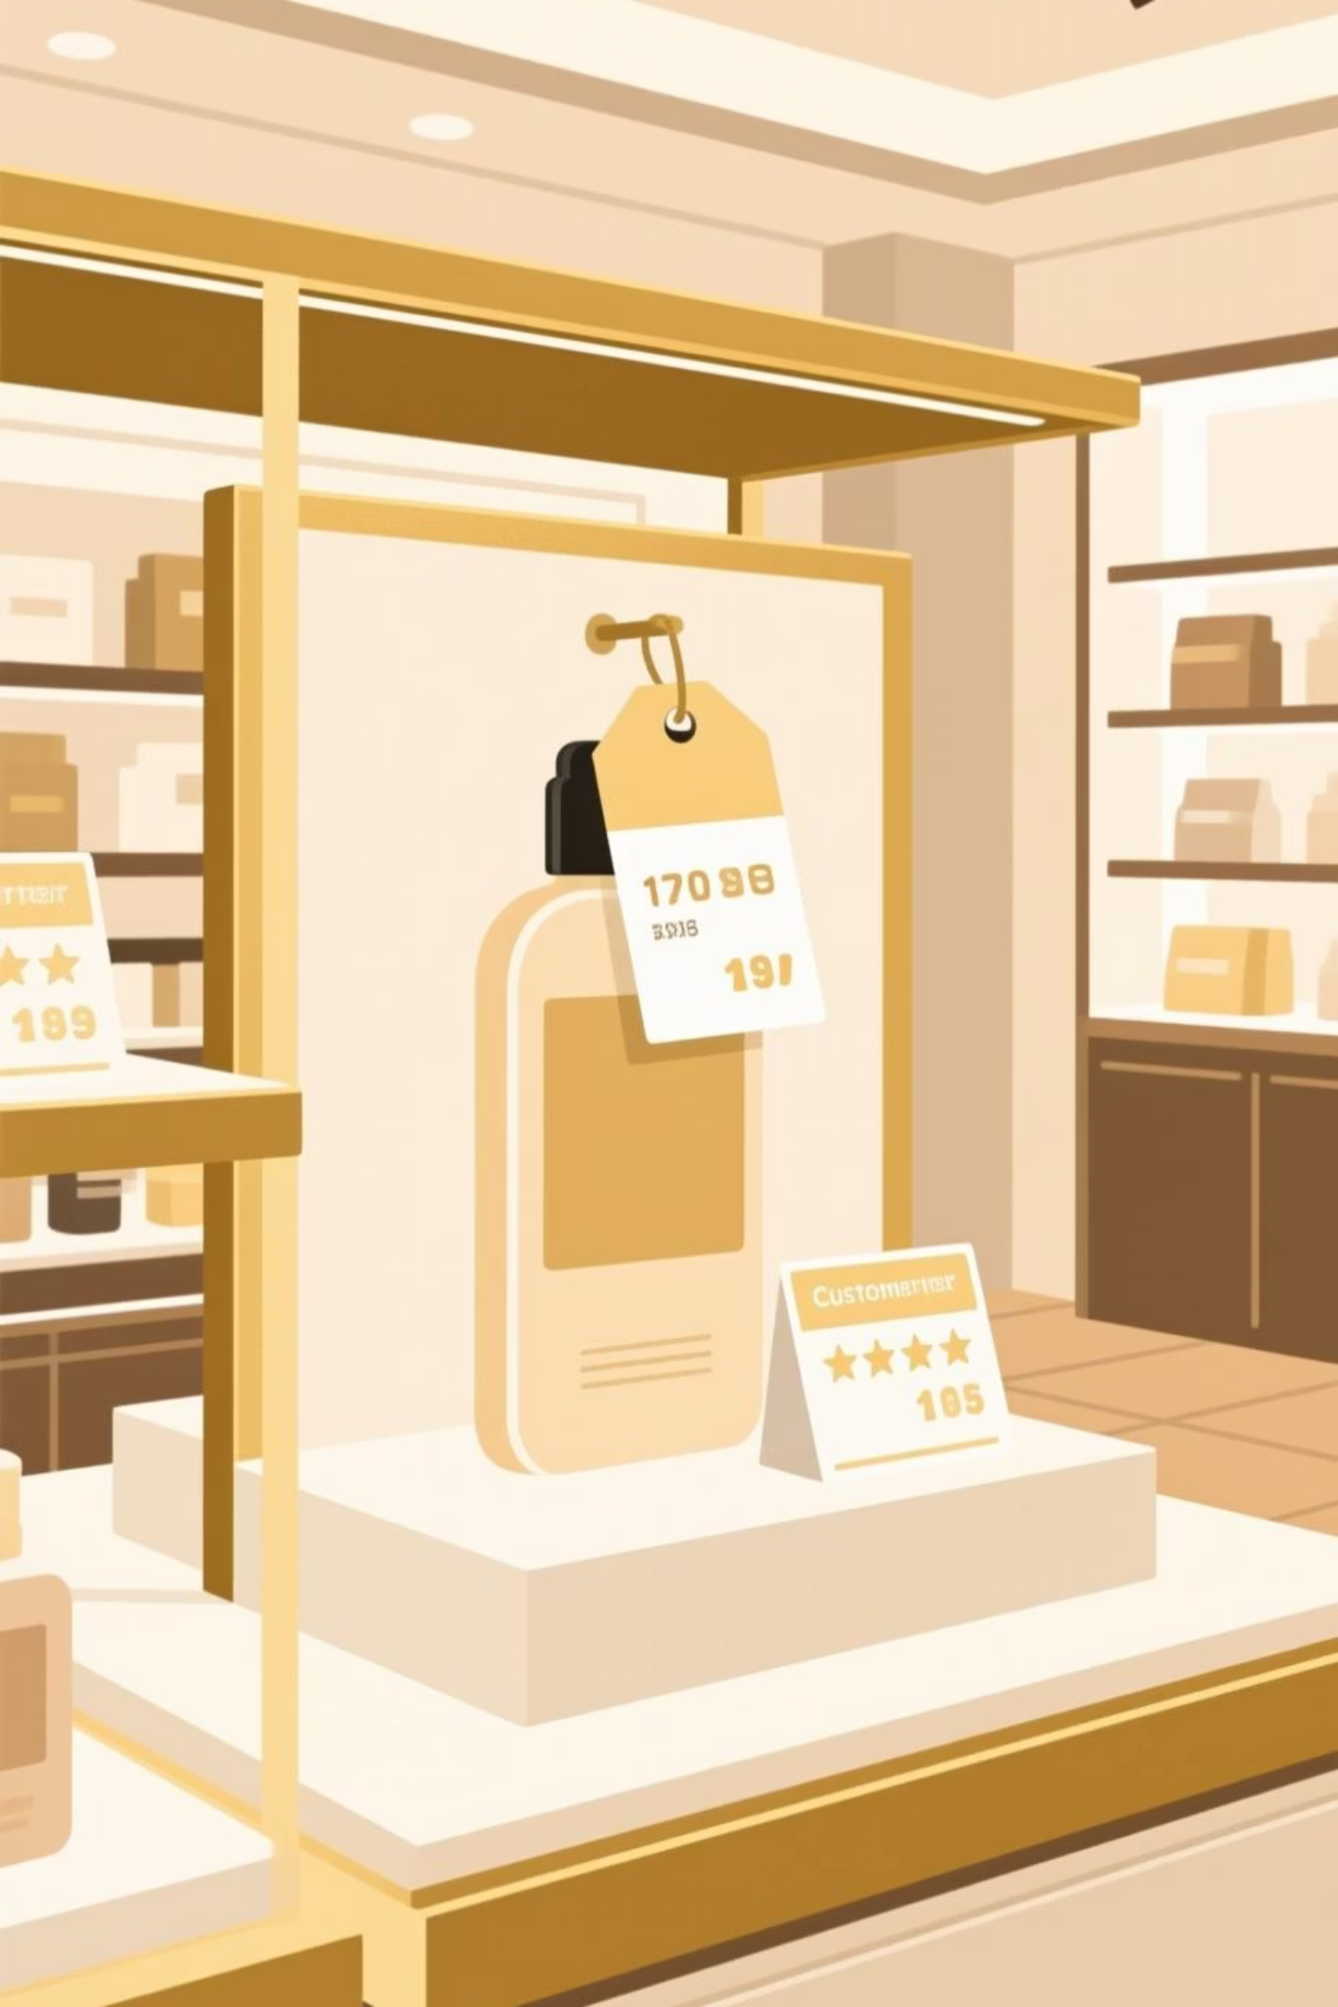
Product Performance Insights
Top-Rated Products
Discount-Dependent Items
Gloves - 3.86 rating
Sandals - 3.84 rating
Hat - 50% discount rate
Boots - 3.82 rating
Sneakers - 49.66%
Hat - 3.80 rating
Coat - 49.07%
Skirt - 3.78 rating
Sweater - 48.17%
Pants - 47.37%

Slide 7

Shipping & Subscription Analysis
Express Shipping
Standard Shipping
$60.48 average purchase
$58.46 average purchase
Premium customers willing to pay more for speed
Cost-conscious shoppers, slight difference in spend
Subscription Status
2,847 non-subscribers vs 1,053 subscribers
Similar avg spend: $59.87 vs $59.49

Slide 8




Customer Segmentation
Loyal
3,116 customers
Returning
701 customers
New
83 customers
Strong loyalty base presents opportunity to convert returning customers into loyal advocates

Slide 9
Revenue by Age Group
Young Adult
$62,143 total revenue - highest contributor
Middle-aged
$59,197 total revenue - strong segment
Adult
$55,978 total revenue - steady performance
Senior
$55,763 total revenue - untapped potential

Slide 10
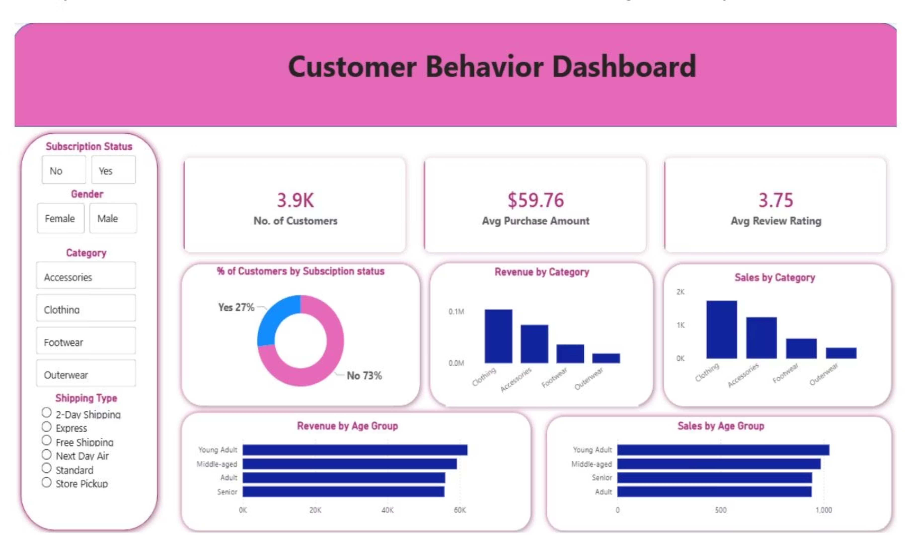

Slide 11

Strategic Recommendations
Boost Subscriptions
Promote exclusive benefits - only 27% currently subscribed despite similar spending patterns
Loyalty Programs
Reward repeat buyers to convert 701 returning customers into loyal segment
Optimize Discounts
Balance promotions with margins - 839 high-spenders use discounts strategically
Targeted Marketing
Focus on Young Adults ($62K revenue) and express shipping users ($60.48 avg)

